Slide 1
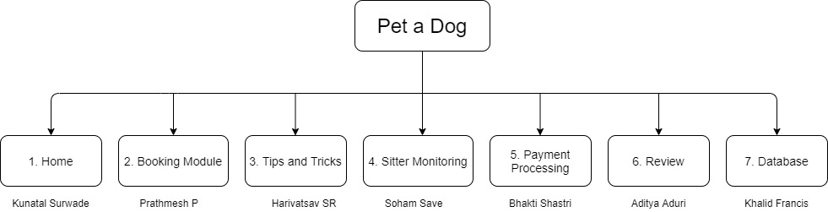
Functional Decomposition Diagram

Slide 2
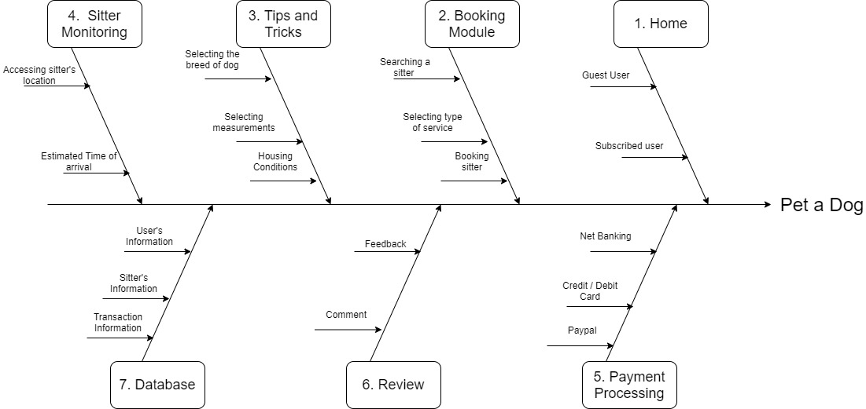
Fishbone Diagram

